Slide 1




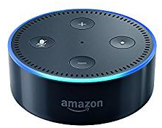








Front-end
https
https
https
Back-end
http
https
EC2
Elastic Load Balancer
S3

Slide 2

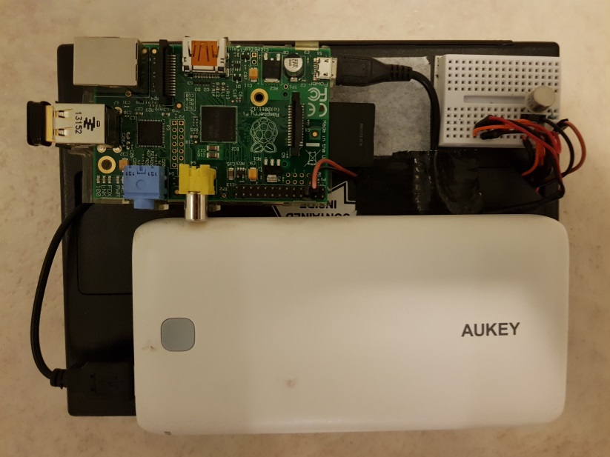



Physical notifier
Lightbox
switch
Lightbox
Lamp
Rechargeable USB
Battery pack
2K
AAAs in lightbox’s
battery compartment
3

